Slide 1
Bayesian Networks

Slide 2
Probabilistic Agent
sensors
?
environment
agent
actuators
I believe that the sun
will still exist tomorrow
with probability 0.999999
and that it will be a sunny
day with probability 0.6

Slide 3
Problem
At a certain time t, the KB of an agent is some collection of beliefs
At time t the agent’s sensors make an observation that changes the strength of one of its beliefs
How should the agent update the strength of its other beliefs?

Slide 4
Purpose of Bayesian Networks
Facilitate the description of a collection of beliefs by making explicit causality relations and conditional independence among beliefs
Provide a more efficient way (than by using joint distribution tables) to update belief strengths when new evidence is observed

Slide 5
Other Names
Belief networks
Probabilistic networks
Causal networks

Slide 6
Bayesian Networks
A simple, graphical notation for conditional independence assertions resulting in a compact representation for the full joint distribution
Syntax:
  a set of nodes, one per variable
  a directed, acyclic graph (link = ‘direct influences’)
  a conditional distribution (CPT) for each node given its parents:
  P(X_{i}|Parents(X_{i}))

Slide 7
Example
Topology of network encodes conditional
independence assertions:
Weather
Cavity
Toothache
Catch
Weather is independent of other variables
Toothache and Catch are independent given Cavity

Slide 8
Example
I’m at work, neighbor John calls to say my alarm is
ringing, but neighbor Mary doesn’t call. Sometime it’s set off by a minor earthquake. Is there a burglar?
Variables: Burglar, Earthquake, Alarm, JohnCalls, MaryCalls
Network topology reflects “causal” knowledge:
- A burglar can set the alarm off
- An earthquake can set the alarm off
- The alarm can cause Mary to call
- The alarm can cause John to call

Slide 9
A Simple Belief Network
Burglary
Earthquake
causes
Intuitive meaning of arrow
from x to y: “x has direct
influence on y”
Alarm
Directed acyclic
graph (DAG)
effects
Nodes are random variables
JohnCalls
MaryCalls

Slide 10
Assigning Probabilities to Roots
Burglary
P(B)
0.001
Earthquake
P(E)
0.002
Alarm
JohnCalls
MaryCalls

Slide 11
Conditional Probability Tables
Burglary
P(B)
0.001
Earthquake
P(E)
0.002
B | E | P(A|B,E)
TTFF | TFTF | 0.95 0.94 0.29 0.001
Alarm
Size of the CPT for a
node with k parents: ?
JohnCalls
MaryCalls

Slide 12
Conditional Probability Tables
Burglary
P(B)
0.001
Earthquake
P(E)
0.002
B | E | P(A|B,E)
TTFF | TFTF | 0.95 0.94 0.29 0.001
Alarm
JohnCalls
A | P(J|A)
TF | 0.90 0.05
MaryCalls
A | P(M|A)
TF | 0.70 0.01

Slide 13
What the BN Means
Burglary
P(B)
0.001
Earthquake
P(E)
0.002
B | E | P(A|…)
TTFF | TFTF | 0.95 0.94 0.29 0.001
Alarm
P(x₁,x₂,…,x_{n}) = Π_{i=1,…,n}P(x_{i}|Parents(X_{i}))
JohnCalls
A | P(J|A)
TF | 0.90 0.05
MaryCalls
A | P(M|A)
TF | 0.70 0.01

Slide 14
Calculation of Joint Probability
Burglary
P(B)
0.001
Earthquake
P(E)
0.002
B | E | P(A|…)
TTFF | TFTF | 0.95 0.94 0.29 0.001
P(J∧M∧A∧¬B∧¬E)
= P(J|A)P(M|A)P(A|¬B,¬E)P(¬B)P(¬E)
= 0.9 x 0.7 x 0.001 x 0.999 x 0.998
= 0.00062
Alarm
JohnCalls
A | P(J|…)
TF | 0.90 0.05
MaryCalls
A | P(M|…)
TF | 0.70 0.01

Slide 15
What The BN Encodes
Burglary
Earthquake
Alarm
For example, John does
not observe any burglaries
directly
JohnCalls
MaryCalls
Each of the beliefs JohnCalls and MaryCalls is independent of Burglary and Earthquake given Alarm or ¬Alarm
The beliefs JohnCalls and MaryCalls are independent given Alarm or ¬Alarm

Slide 16
What The BN Encodes
Burglary
Earthquake
For instance, the reasons why
John and Mary may not call if
there is an alarm are unrelated
Alarm
JohnCalls
MaryCalls
Each of the beliefs JohnCalls and MaryCalls is independent of Burglary and Earthquake given Alarm or ¬Alarm
The beliefs JohnCalls and MaryCalls are independent given Alarm or ¬Alarm
Note that these reasons could
be other beliefs in the network.
The probabilities summarize these
non-explicit beliefs

Slide 17
Structure of BN
The relation:
P(x₁,x₂,…,x_{n}) = Π_{i=1,…,n}P(x_{i}|Parents(X_{i}))
means that each belief is independent of its predecessors in the BN given its parents
Said otherwise, the parents of a belief X_{i} are all the beliefs that “directly influence” X_{i}
Usually (but not always) the parents of X_{i} are its causes and X_{i} is the effect of these causes
E.g., JohnCalls is influenced by Burglary, but not
directly. JohnCalls is directly influenced by Alarm

Slide 18
Construction of BN
Choose the relevant sentences (random variables) that describe the domain
Select an ordering X₁,…,X_{n}, so that all the beliefs that directly influence X_{i} are before X_{i}
For j=1,…,n do:
  Add a node in the network labeled by X_{j}
  Connect the node of its parents to X_{j}
  Define the CPT of X_{j}
The ordering guarantees that the BN
will have no cycles

Slide 19
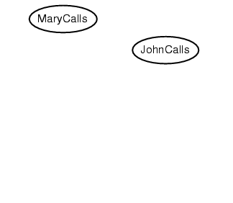
Example
Suppose we choose the ordering M, J, A, B, E
P(J | M) = P(J)?

Slide 20
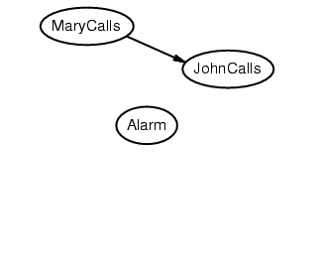
Example
Suppose we choose the ordering M, J, A, B, E
P(J | M) = P(J)? No
P(A | J, M) = P(A | J)? P(A | J, M) = P(A)?

Slide 21
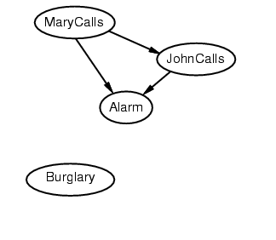
Example
Suppose we choose the ordering M, J, A, B, E
P(J | M) = P(J)? No
P(A | J, M) = P(A | J)? P(A | J, M) = P(A)? No
P(B | A, J, M) = P(B | A)?
P(B | A, J, M) = P(B)?

Slide 22
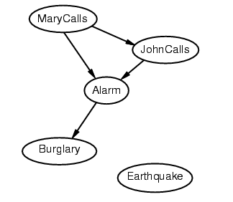
Example
Suppose we choose the ordering M, J, A, B, E
P(J | M) = P(J)? No
P(A | J, M) = P(A | J)? P(A | J, M) = P(A)? No
P(B | A, J, M) = P(B | A)? Yes
P(B | A, J, M) = P(B)? No
P(E | B, A ,J, M) = P(E | A)?
P(E | B, A, J, M) = P(E | A, B)?

Slide 23
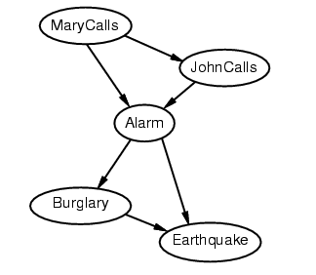
Example
Suppose we choose the ordering M, J, A, B, E
P(J | M) = P(J)? No
P(A | J, M) = P(A | J)? P(A | J, M) = P(A)? No
P(B | A, J, M) = P(B | A)? Yes
P(B | A, J, M) = P(B)? No
P(E | B, A ,J, M) = P(E | A)? No
P(E | B, A, J, M) = P(E | A, B)? Yes

Slide 24
Example summary
Deciding conditional independence is hard in noncausal directions
(Causal models and conditional independence seem hardwired for humans!)
Network is less compact: 1 + 2 + 4 + 2 + 4 = 13 numbers needed

Slide 25
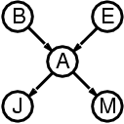
Compactness
A CPT for Boolean Xi with k Boolean parents has 2k rows for the combinations of parent values
Each row requires one number p for Xi = true
(the number for Xi = false is just 1-p)
If each variable has no more than k parents, the complete network requires O(n · 2k) numbers
I.e., grows linearly with n, vs. O(2n) for the full joint distribution
For burglary net, 1 + 1 + 4 + 2 + 2 = 10 numbers (vs. 25-1 = 31)

Slide 26
Cond. Independence Relations
Ancestor
1. Each random variable X, is conditionally independent of its non-descendents, given its parents Pa(X)
Formally,
I(X; NonDesc(X) | Pa(X))
2. Each random variable is conditionally independent of all the other nodes in the graph, given its neighbor
Parent
Y₁
Y₂
X
Non-descendent
Non-descendent
Descendent

Slide 27
Inference in BNs
Set E of evidence variables that are observed, e.g., {JohnCalls,MaryCalls}
Query variable X, e.g., Burglary, for which we would like to know the posterior probability distribution P(X|E)
J
M
P(B|…)
T
T
?
Distribution conditional to
the observations made

Slide 28
Inference Patterns
Burglary
Earthquake
Burglary
Earthquake
Basic use of a BN: Given new
observations, compute the new
strengths of some (or all) beliefs
Alarm
Diagnostic
Alarm
Causal
JohnCalls
MaryCalls
JohnCalls
MaryCalls
Other use: Given the strength of
a belief, which observation should
we gather to make the greatest
change in this belief’s strength
Burglary
Earthquake
Burglary
Earthquake
Alarm
Intercausal
Alarm
Mixed
JohnCalls
MaryCalls
JohnCalls
MaryCalls

Slide 29
Types Of Nodes On A Path
diverging
Battery
linear
Radio
SparkPlugs
Gas
Starts
converging
Moves

Slide 30
Independence Relations In BN
diverging
Battery
linear
Radio
SparkPlugs
Gas
Given a set E of evidence nodes, two beliefs
connected by an undirected path are
independent if one of the following three
conditions holds:
1. A node on the path is linear and in E
2. A node on the path is diverging and in E
3. A node on the path is converging and
neither this node, nor any descendant is in E
Starts
converging
Moves

Slide 31
Independence Relations In BN
diverging
Battery
linear
Radio
SparkPlugs
Gas
Given a set E of evidence nodes, two beliefs
connected by an undirected path are
independent if one of the following three
conditions holds:
1. A node on the path is linear and in E
2. A node on the path is diverging and in E
3. A node on the path is converging and
neither this node, nor any descendant is in E
Starts
converging
Gas and Radio are independent
given evidence on SparkPlugs
Moves

Slide 32
Independence Relations In BN
diverging
Battery
linear
Radio
SparkPlugs
Gas
Given a set E of evidence nodes, two beliefs
connected by an undirected path are
independent if one of the following three
conditions holds:
1. A node on the path is linear and in E
2. A node on the path is diverging and in E
3. A node on the path is converging and
neither this node, nor any descendant is in E
Gas and Radio are independent
given evidence on Battery
Starts
converging
Moves

Slide 33
Independence Relations In BN
diverging
Battery
linear
Radio
SparkPlugs
Gas
Given a set E of evidence nodes, two beliefs
connected by an undirected path are
independent if one of the following three
conditions holds:
1. A node on the path is linear and in E
2. A node on the path is diverging and in E
3. A node on the path is converging and
neither this node, nor any descendant is in E
Gas and Radio are independent
given no evidence, but they are
dependent given evidence on
Starts or Moves
Starts
converging
Moves

Slide 34
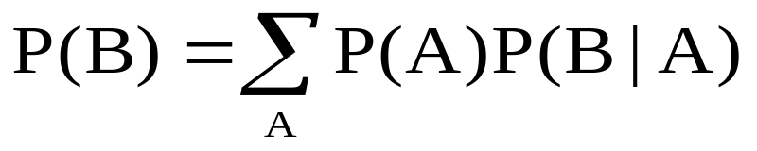
BN Inference
Simplest Case:
A
B
P(B) = P(a)P(B|a) + P(~a)P(B|~a)
A
B
C
P(C) = ???

Slide 35
BN Inference
Chain:
X1
X2
…
Xn
What is time complexity to compute P(Xn)?
What is time complexity if we computed the full joint?

Slide 36
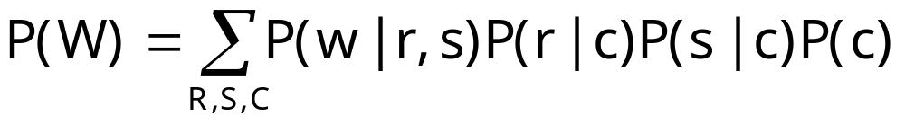
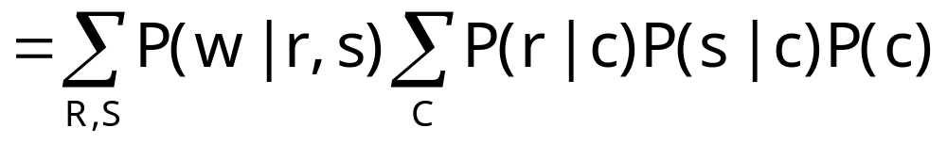
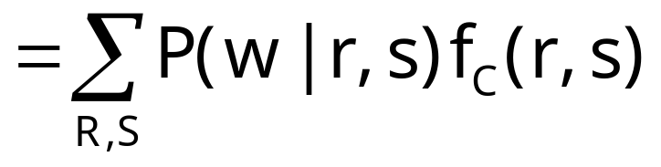
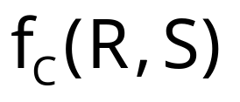
Inference Ex. 2
Algorithm is computing not individual
probabilities, but entire tables
Cloudy
Two ideas crucial to avoiding exponential blowup:
  because of the structure of the BN, some
  subexpression in the joint depends only on a small number
  of variables
  By computing them once and caching the result, we
  can avoid generating them exponentially many times
Sprinkler
Rain
WetGrass

Slide 37
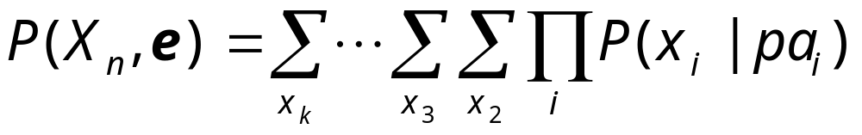
Variable Elimination
General idea:
Write query in the form
Iteratively
  Move all irrelevant terms outside of innermost sum
  Perform innermost sum, getting a new term
  Insert the new term into the product

Slide 38
A More Complex Example
“Asia” network:
Visit to
Asia
Smoking
Tuberculosis
Lung Cancer
Abnormality
in Chest
Bronchitis
X-Ray
Dyspnea

Slide 39
V
S
We want to compute P(d)
Need to eliminate: v,s,x,t,l,a,b
Initial factors
T
L
A
B
X
D

Slide 40
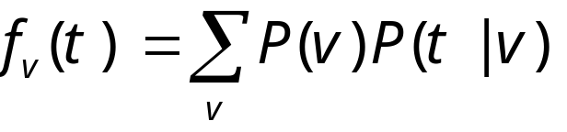
V
S
We want to compute P(d)
Need to eliminate: v,s,x,t,l,a,b
Initial factors
T
L
A
B
X
D
Eliminate: v
Compute:
Note: f_{v}(t) = P(t)
In general, result of elimination is not necessarily a probability term

Slide 41
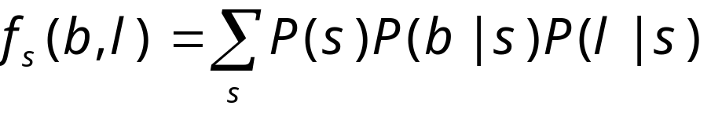
V
S
We want to compute P(d)
Need to eliminate: s,x,t,l,a,b
Initial factors
T
L
A
B
X
D
Eliminate: s
Compute:
Summing on s results in a factor with two arguments f_{s}(b,l)
In general, result of elimination may be a function of several variables

Slide 42
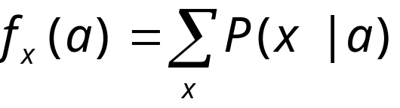
V
S
We want to compute P(d)
Need to eliminate: x,t,l,a,b
Initial factors
T
L
A
B
X
D
Eliminate: x
Compute:
Note: f_{x}(a) = 1 for all values of a !!

Slide 43
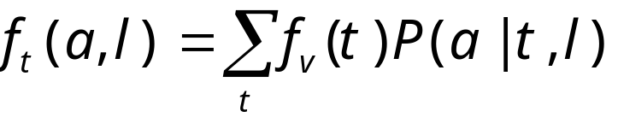
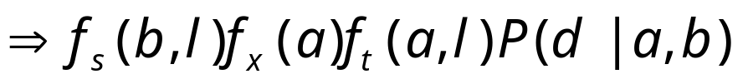
V
S
We want to compute P(d)
Need to eliminate: t,l,a,b
Initial factors
T
L
A
B
X
D
Eliminate: t
Compute:

Slide 44
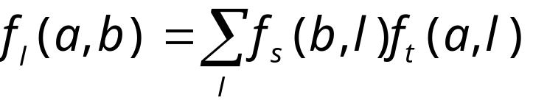
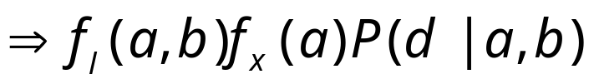
V
S
We want to compute P(d)
Need to eliminate: l,a,b
Initial factors
T
L
A
B
X
D
Eliminate: l
Compute:

Slide 45

V
S
We want to compute P(d)
Need to eliminate: b
Initial factors
T
L
A
B
X
D
Eliminate: a,b
Compute:

Slide 46
Variable Elimination
We now understand variable elimination as a sequence of rewriting operations
Actual computation is done in elimination step
Computation depends on order of elimination

Slide 47
Dealing with evidence
V
S
T
L
A
B
How do we deal with evidence?
Suppose get evidence V = t, S = f, D = t
We want to compute P(L, V = t, S = f, D = t)
X
D

Slide 48
Dealing with Evidence
V
S
T
L
A
B
We start by writing the factors:
Since we know that V = t, we don’t need to eliminate V
Instead, we can replace the factors P(V) and P(T|V) with
These “select” the appropriate parts of the original factors given the evidence
Note that f_{p(V)} is a constant, and thus does not appear in elimination of other variables
X
D

Slide 49
Dealing with Evidence
V
S
T
L
Given evidence V = t, S = f, D = t
Compute P(L, V = t, S = f, D = t )
Initial factors, after setting evidence:
A
B
X
D

Slide 50
Dealing with Evidence
V
S
T
L
Given evidence V = t, S = f, D = t
Compute P(L, V = t, S = f, D = t )
Initial factors, after setting evidence:
Eliminating x, we get
A
B
X
D

Slide 51
Dealing with Evidence
V
S
T
L
Given evidence V = t, S = f, D = t
Compute P(L, V = t, S = f, D = t )
Initial factors, after setting evidence:
Eliminating x, we get
Eliminating t, we get
A
B
X
D

Slide 52
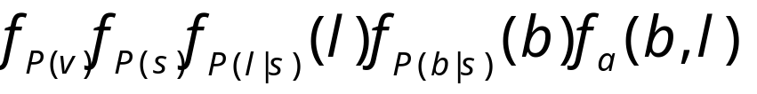
Dealing with Evidence
V
S
T
L
Given evidence V = t, S = f, D = t
Compute P(L, V = t, S = f, D = t )
Initial factors, after setting evidence:
Eliminating x, we get
Eliminating t, we get
Eliminating a, we get
A
B
X
D

Slide 53
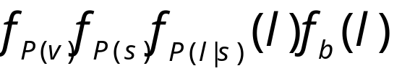
Dealing with Evidence
V
S
T
L
Given evidence V = t, S = f, D = t
Compute P(L, V = t, S = f, D = t )
Initial factors, after setting evidence:
Eliminating x, we get
Eliminating t, we get
Eliminating a, we get
Eliminating b, we get
A
B
X
D

Slide 54
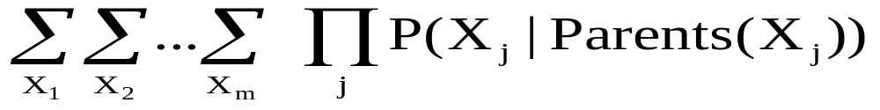
Variable Elimination Algorithm
Let X1,…, Xm be an ordering on the non-query variables
For I = m, …, 1
  Leave in the summation for Xi only factors mentioning Xi
  Multiply the factors, getting a factor that contains a number for each value of the variables mentioned, including Xi
  Sum out Xi, getting a factor f that contains a number for each value of the variables mentioned, not including Xi
  Replace the multiplied factor in the summation

Slide 55
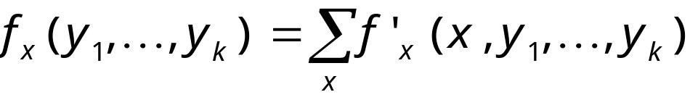
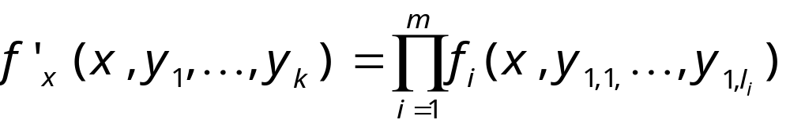
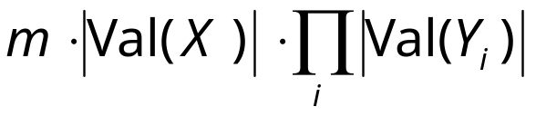
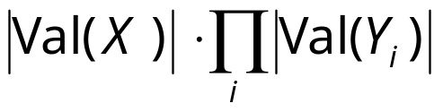
Complexity of variable elimination
Suppose in one elimination step we compute
This requires
multiplications
  For each value for x, y₁, …, y_{k}, we do m multiplications
additions
  For each value of y₁, …, y_{k} , we do |Val(X)| additions
Complexity is exponential in number of variables in the intermediate factor!

Slide 56
Understanding Variable Elimination
We want to select “good” elimination orderings that reduce complexity
This can be done be examining a graph theoretic property of the “induced” graph; we will not cover this in class.
This reduces the problem of finding good ordering to graph-theoretic operation that is well-understood—unfortunately computing it is NP-hard!

Slide 57
Exercise: Variable elimination
p(study)=.6
smart
study
p(smart)=.8
p(fair)=.9
prepared
fair
Sm | St | P(Pr|Sm,St)
T T F F | T F T F | .9 .5 .7 .1
pass
Sm | Pr | F | P(Pa|Sm,Pr,F)
T T T T F F F F | T T F F T T F F | T F T F T F T F | .9 .1 .7 .1 .7 .1 .2 .1
Query: What is the probability that a student is smart, given that they pass the exam?

Slide 58
Approaches to inference
Exact inference
  Inference in Simple Chains
  Variable elimination
  Clustering / join tree algorithms
Approximate inference
  Stochastic simulation / sampling methods
  Markov chain Monte Carlo methods

Slide 59
Stochastic simulation - direct
Suppose you are given values for some subset of the variables, G, and want to infer values for unknown variables, U
Randomly generate a very large number of instantiations from the BN
  Generate instantiations for all variables – start at root variables and work your way “forward”
Rejection Sampling: keep those instantiations that are consistent with the values for G
Use the frequency of values for U to get estimated probabilities
Accuracy of the results depends on the size of the sample (asymptotically approaches exact results)

Slide 60
Direct Stochastic Simulation
Cloudy
P(WetGrass|Cloudy)?
P(WetGrass|Cloudy)
= P(WetGrass ∧ Cloudy) / P(Cloudy)
Sprinkler
Rain
1. Repeat N times:
1.1. Guess Cloudy at random
1.2. For each guess of Cloudy, guess
Sprinkler and Rain, then WetGrass
2. Compute the ratio of the # runs where
WetGrass and Cloudy are True
over the # runs where Cloudy is True
WetGrass

Slide 61
Exercise: Direct sampling
p(study)=.6
smart
study
p(smart)=.8
p(fair)=.9
prepared
fair
Sm | St | P(Pr|…)
T T F F | T F T F | .9 .5 .7 .1
pass
Sm | Pr | F | P(Pa|…)
T T T T F F F F | T T F F T T F F | T F T F T F T F | .9 .1 .7 .1 .7 .1 .2 .1
Topological order = …?
Random number generator: .35, .76, .51, .44, .08, .28, .03, .92, .02, .42

Slide 62
Likelihood weighting
Idea: Don’t generate samples that need to be rejected in the first place!
Sample only from the unknown variables Z
Weight each sample according to the likelihood that it would occur, given the evidence E

Slide 63
Markov chain Monte Carlo algorithm
So called because
  Markov chain – each instance generated in the sample is dependent on the previous instance
  Monte Carlo – statistical sampling method
Perform a random walk through variable assignment space, collecting statistics as you go
  Start with a random instantiation, consistent with evidence variables
  At each step, for some nonevidence variable, randomly sample its value, consistent with the other current assignments
Given enough samples, MCMC gives an accurate estimate of the true distribution of values

Slide 64
Exercise: MCMC sampling
p(smart)=.8
p(study)=.6
smart
study
p(fair)=.9
prepared
fair
Sm | St | P(Pr|…)
T T F F | T F T F | .9 .5 .7 .1
pass
Sm | Pr | F | P(Pa|…)
T T T T F F F F | T T F F T T F F | T F T F T F T F | .9 .1 .7 .1 .7 .1 .2 .1
Topological order = …?
Random number generator: .35, .76, .51, .44, .08, .28, .03, .92, .02, .42

Slide 65
Summary
Bayes nets
  Structure
  Parameters
  Conditional independence
BN inference
  Exact Inference
    Variable elimination
  Sampling methods

Slide 66

Applications
http://excalibur.brc.uconn.edu/~baynet/researchApps.html
Medical diagnosis, e.g., lymph-node deseases
Fraud/uncollectible debt detection
Troubleshooting of hardware/software systems

